Slide 1

HACKATHON PROPOSAL OPEN TRACK
“THE KEPLER EXOPLANET CATALOG”
21UPE006 | 21UPE044 | 21UPE016

Slide 2

AGENDA
ABOUT US
IDEA OVERVIEW
PROTOTYPE OVERVIEW
DEVELOPMENT STRATEGY
SOURCES

Slide 3
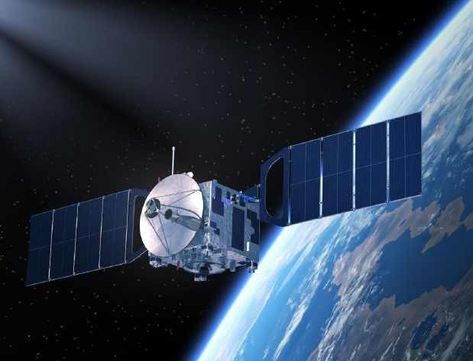
ABOUT US
Meet The Team!
Arghya Ranjan Patwari | 21UPE006
Anubhab Saha | 21UPE044
Tanish Sai E. | 21UPE006 Hello!
We at SkyWatch are composed of three guys who deeply understand the passion and importance of Space Sciences and the monumental effort that’s involved.
With this proposal we would like to make sense of the titanic volumes of data and contribute in our own simple way.

Slide 4
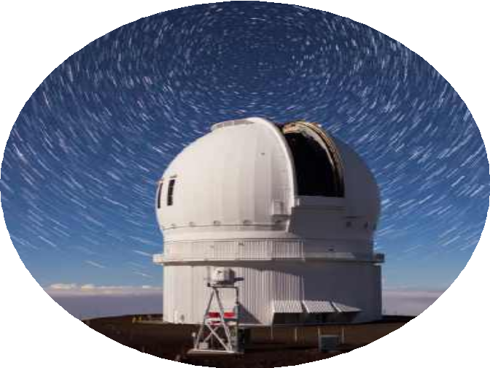
IDEA OVERVIEW
THE EXOPLANET CATALOGUE IS A DATA VISUALIZATION TOOL BUILT TO HELP ORGANIZE AND PRESENT DATA REGARDING EXOPLANETS IN A USER-FRIENDLY WAY.
WITH OUR DATA SOURCED FROM NASA’S KEPLER EXOPLANET DATABASE , ACCURACY AND RELIABILITY IS ENSURED.
POWERED BY JUPYTER , WE ENSURE CROSS PLATFORM COMPATIBILITY WITH A CODEBASE THAT’S EASY TO USE AND USER – FRIENDLY.

Slide 5
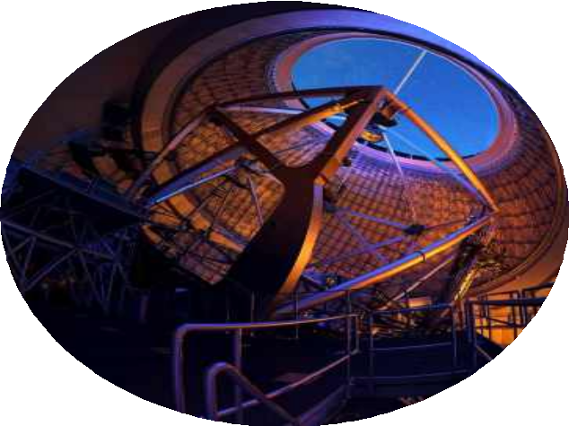
ENHANCED ORGANIZATION OF DATA
FASTER INSIGHTS INTO A COMPLEX DATASET
USER-FRIENDLY WAY OF BROWSING KEPLER BASE INFORMATION ON EXOPLANETS
ACCURATE AND RELIABLE DATASET SOURCED FROM NASA & KAGGLE.
PLUG AND PLAY STYLE OF MODEL ENABLES INTEGRATION WITH OTHER PROJECTS
IDEA BENEFITS

Slide 6
MODEL OVERVIEW

Slide 7

MODEL TRAINED AND POWERED BY KAGGLE INFRASTRUCTURE.
ACCURATE AND RELIABLE UP TO 10000 UNIQUE EXOPLANET ENTRIES
PROVIDES VISUALIZED INFO ON VARIOUS PARAMETERS LIKE SOLAR RADII , ORBIT PARAMETERS AND EARTH SIMILARITY COEFFICIENT
USER-FRIENDLY CODEBASE
CAN SORT EXOPLANETS ACCORDING TO 19 DISTINCT PARAMETERS
FEATURES OF MODEL

Slide 8
IMMEDIATE GOALS
DEVELOPMENT STRATEGY
Optimize codebase for moderate user traffic.
Integrate larger , updated and more expansive datasets such as the 2024 Stellar Classification Dataset provided by NASA.
EXPAND
Dataset entries and update pre- existing entries.
EXPLORE
Integrate more stellar planet types and a
more expansive dataset
ENHANCE
Ensure a tailored and user- focused experience through
the development of
alternatives such as a website
and/or app.

Slide 9
FUTURE GOALS OF THE MODEL
Phase Alpha
Successful introduction of our ai model to early testers who would stress test it and find out the limitations of our model.
Phase Beta
Open access to the public to gauge public feedback and start development towards a website.
Phase Release
Complement the release of the model in its final form along with a mobile app to increase user access.
Milestone | Timeline
Phase Alpha | 19th-21st Aug
Phase Beta | 23rd Aug
Website goes Online | 31st Aug
Phase Release | 25th Sep

Slide 10
PROTOTYPE ACCESS INFO & SOURCE INF 0
Until Phase Beta is complete and we have a working model , all interested users will have to access the model and the data in 3 possible ways –
Jupyter Notebook (On Device)
Kaggle Notebook (Online)
Google Collab Notebook (Online)
Attached Below is the Github Link containing all the necessary files for the prototype:
GitHub:
STRONG MARKET POSITIONING
ROBUST GROWTH STRATEGY
INNOVATIVE PRODUCT DEVELOPMENT
COMMITMENT TO USER SATISFACTION

Slide 11
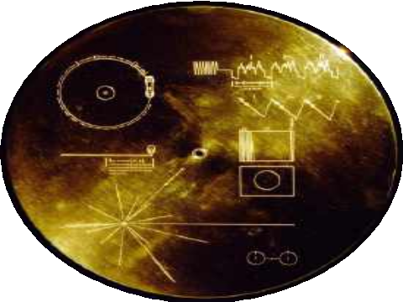
THANK YOU
ARGHYA RANJAN PATWARI | ANUBHAB SAHA | TANISH SAI E.

